Slide 1

CMN 1160B – Introduction to Media Studies
Week 6B: Theoretical Perspectives on Audiences
Daniel J. Paré
University of Ottawa, Department of Communication
October 13, 2016
Notes:
1

Slide 2
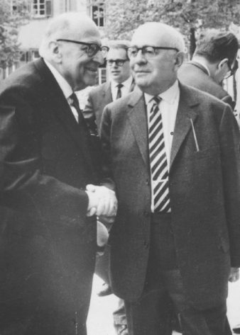
The Frankfurt School
Media integrates audiences into the capitalist system
Mass communication and content have replaced high culture.
Wants and desires created and satisfied through the marketplace.
Culture is now the product of industrial capitalism (i.e., the culture industry).

Slide 3
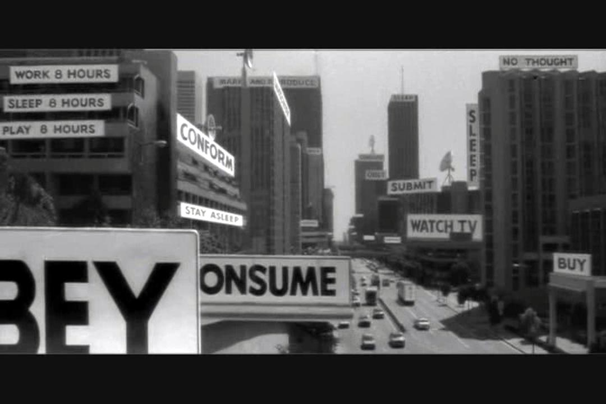
The Frankfurt School
Who owns Canada’s media?

Slide 4
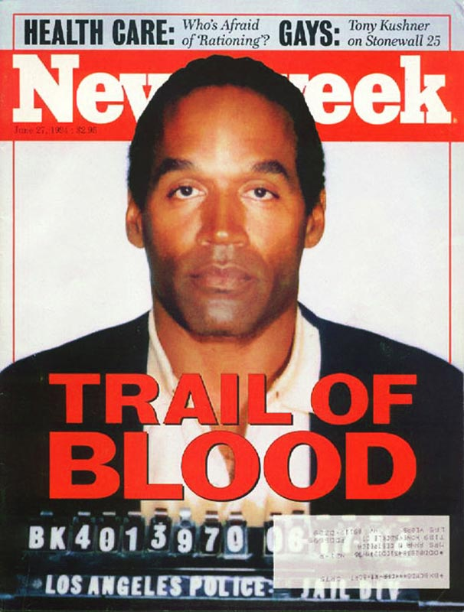
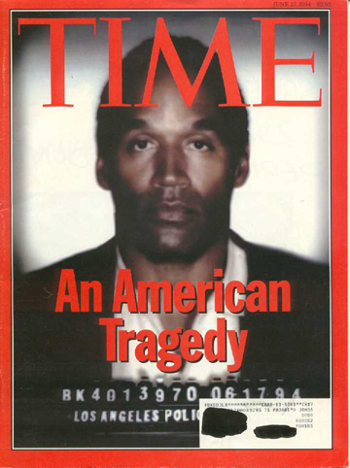

Slide 5
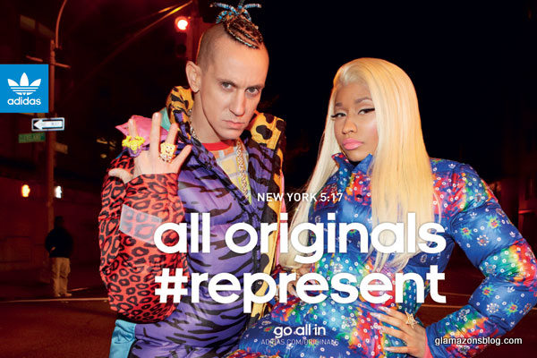
Standardization and Pseudo-Individualism

Slide 6
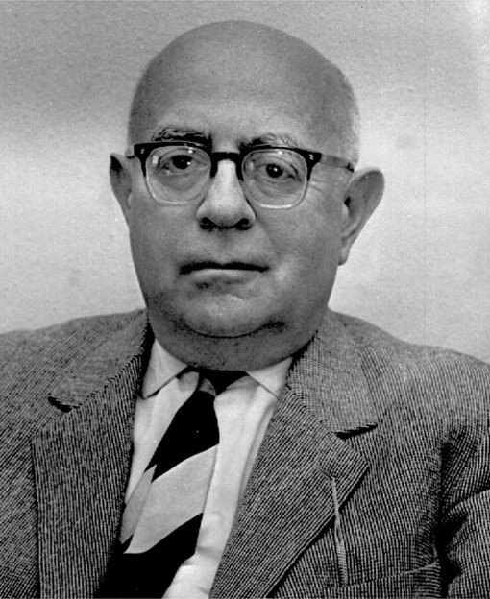
Art is permitted to survive only if it renounces the right to be different, and integrates itself into the omnipotent realm of the profane.
The culture industry not so much adapts to the reactions of its customers as it counterfeits them.

Slide 7

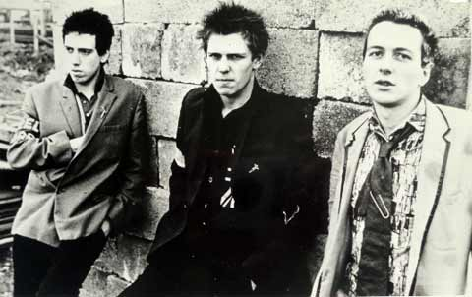
Cultural Studies
Reaction to Marxist theory
The public is not a passive media consumer; individuals can subvert and manipulate media to create new meanings
Roles of ideologies in controlling society

Slide 8
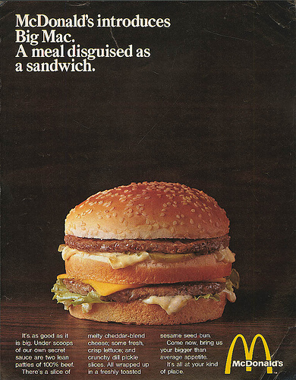
Stuart Hall
Preferred, Negotiated and Oppositional readings of media texts
For example…

Slide 9
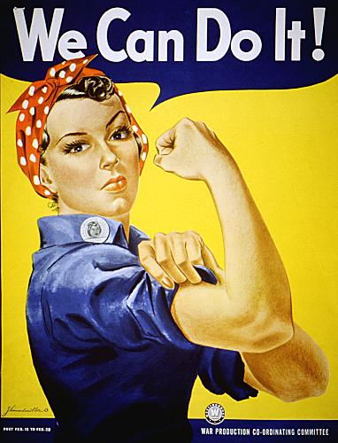
Feminist Research
Analyzes male social dominance as the root of inequality and injustice (i.e., patriarchy).
Relationship between media and society’s dominant ideas about gender roles
3 dimensions of feminist study (Andrea Press):
feminism, difference, and identity
feminism and the public sphere
new technologies and the body

Slide 10
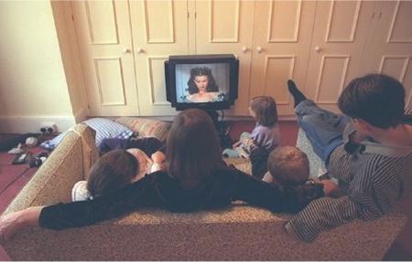
Gender, Class and Media

Slide 11
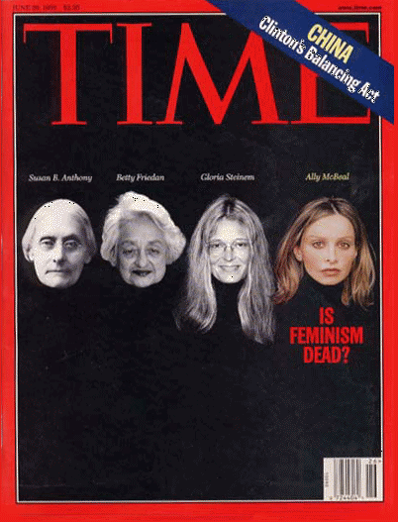
Feminist Media Criticism
1970s
Transmission model
Content analysis
Some semiotic analysis and ideological analysis
1980s
Post-structuralism
Pleasure of media
Meaning is fluid
1990s
Audience Studies
Questioning of the feminist critique
2000s
Post-feminism?

Slide 12
Information is unmediated
Also called the ‘limited effects paradigm’
HYPODERMIC NEEDLE MODEL
TWO STEP FLOW MODEL
Dating from 1920s
Passive audience
Opinion leaders influence how audiences consume texts
Texts have preferred meaning
RECEPTION ANALYSIS/ THEORIES
USES AND GRATIFICATIONSTHEORY
Stuart Hall’s Encoding/Decoding model
Audiences consume texts for different reasons and in different ways

